Slide 1
Security Engineering CSE 352/CSE 552 Instructor: Sambuddho Chakravarty
(Semester: Winter 2016)
Final Review: April 18

Slide 2
Where are We ?
Secrecy – History of cryptography: Ceaser ciphers/replacement ciphers, steganography, Vignere Ciphers (polyalphabetic substitution), Enigma Machine (20th Century), OTPs, Stream Ciphers (PRNG), Block Ciphers (PRPs and PRFs), DES (broken), 3DES (slow), AES 128/256 (Used most often and considered relatively secure)
Computer Security is not merely Crytography however…
Systems security – software systems and infrastructure level security – OS level security, software vulnerabilities, defending against software level vulnerabilities.
Network security – vulnerabilities of network infrastructure, DoS attacks, MITM attacks, eavesdropping (secrecy/confidentiality), authenticity of messages (integrity protection and authorization), anonymity and privacy.
Mobile/wireless communications security – hardware level vulnerabilities, signal and protocol level vulnerabilities (signal jamming, MAC layer vulns.), platform level vulns., application layer vulns.
Web Security: Extends network security – various forms of remote script execution attacks, protecting the databases.
Emergent Areas of Security – Hardware security, security in IoT, Privacy preserving anonymous transactions.

Slide 3
What Have We Been Doing ?
Traditional Access Control Models – DAC, MAC, RBAC
Security models:
Clearance Levels
Multilevel Security (MLS)
Subjects and objects
Bell LaPadula Model
Biba Model

Slide 4
Bell-LaPadula Model
3 main principles:
The Simple Security Property: A subject can read an object only if the class of the subject dominates or equals the class of the object; aka no-read-up rule: A subject cannot read data from an object “above” it in the lattice.
The *-Property (aka no-write-down rule): If a subject has simultaneous read access to object O1 and write access to O2 then O2 ≥ O1. Prevents (un)intended “leakage” of sensitive information.
Discretionary Security Property: S operates on O iff permitted by the access control matrix.

Slide 5
The Biba Model
“Reversed” Bell-LaPadula Model: S and O are organized as per the integrity levels (unlike Bell LaPadula which is organized as per Confidentiality).
Prevent leakage of information from objects of higher integrity level to subjects of lower levels of integrity.
Prevent contamination of objects of higher integrity level from being written to by subjects (actions) with lower levels of integrity.
Simple Integrity Axiom: No-read-down
The *Integrity Axiom: No-write-up
Invocation Property

Slide 6
Contemporary Relevance of Classical Models
Is Bell-LaPadula/Biba model relevant for modern systems ? (Yes/No/Maybe)
Yes/Maybe: Novel approach to model security of systems as subjects and objects and ensures some form of confidentiality across various clearance-levels.
No:
Modern systems’ security is rooted in interface security.
Very often attacked because programs do not correctly check the boundary conditions.
Running code of on level at another level’s security – running your cod with my privilege levels.
Too Unwieldy
How to maintain flow in only one direction for complex lattice may break OS enforced barriers – e.g. page boundaries of different processes having different permissions.
Manageability – Grouping users into categories and labelling them, adding removing new users to existing group(s).
Doesn’t fit with various modern system designs e.g. Microkernels, embedded/mobile/low resource OSes designed keeping performance in mind (even Monolithic ones…).
Does not consider modern security concerns like Privacy/Anonymity etc.
Trusthworthy computing: Has different connotations wrt modern computing world.

Slide 7
Saltzer and Schroeder Model
Contemporaneous to Bell-LaPadula and Biba Model
Economy of mechanism: Keeping design simple (aka KISS model)
Fail-safe defaults: Default action of the system that should be to deny access to
someone or something until it has been explicitly granted the necessary privileges.
Unhandled error could leave the system in an insecure state.
Complete mediation: Every object access needs to be authorized.
Open design: Obscurity doesn’t lead to security (e.g. MS has been criticized in the past for closed designs that were ultimately insecure)
Separation of privileges.
Least privileges: A user/process should operate with the smallest set of privileges necessary to complete the given task.
Least-common mechanism: Least possible sharing of information or resource between users. Could leak to inadvertent flow of information (Confinement problem).
Psychological acceptability/usability

Slide 8
Discretionary Access Controls: The Lowest Common Denominator
Subject has complete control over who access his (or her) resources.
Most common examples: Linux or Windows files.
drwx--- --- root root 1024 Oct 21 2015 12:34 file1
Windows file permissions.
Access control lists
Provides finer control than what is provided by the standard permission bits.
E.g. allow individual users to access or deny files or directories.

Slide 9
Setuid, Setgid
Purpose: Privileged access. A program with the setuid or setgid bit set executes as the owner (or group) of the program.
Safe ways to use setuid() functions:
User A’s process access user B’s programs – performs the necessary execution as user B
User B’s program performs the privileged operation and then goes back to user A’s permissions.
Principle of least privileges
A’s program → B’s program
{
unprivileged operations;
real_uid = getuid(); //get calling processes uid
privileged operations;
seteuid(real_uid); //relinquish privileges
}

Slide 10
Mandatory Access Controls in Linux: SELinux
Discretionary Access Controls cannot solve all problems –
Owner sets access privileges for files.
Infeasible to set privileges of ALL files in the system.
No mediated access
Recall SUID vulnerabilities
Need a second line of defense if the DAC is compromised.
First line of defense DAC. If allowed by DAC then MAC is checked (enforced).
What all can you do with SELinux –
Enforce MAC/RBAC.
Fine tuned access control, that acts as second line of defense.
Administrator can enforce which system calls a (or a certain class) of users can use.

Slide 11
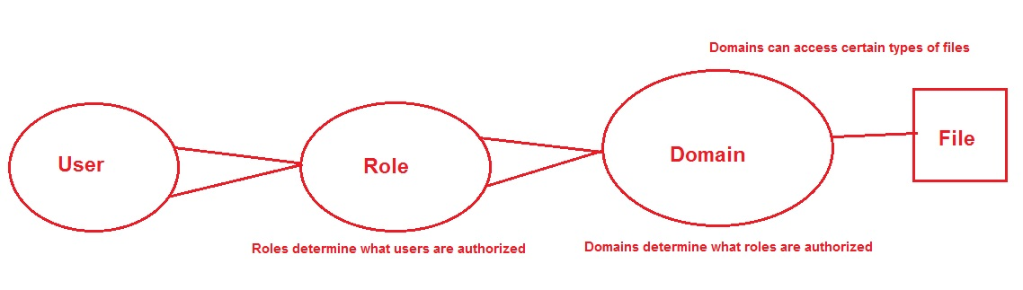
Mandatory Access Controls in Linux: SELinux
The basics (Policy)
Users
Roles – Defines a set of users that can access a process
Subjects and Objects
Domain – A context within which a subject (user or process) operates.
Type – Loose classification of a group of files – associated with its purpose. E.g. files in /etc directory may be classified as one type.
Policy –

Slide 12
Mandatory Access Controls in Linux: SELinux
Context inheritance –
Unless otherwise specified the files and processs are created with contexts of their parent files or processes
For files: Copying to “out-of-context” locations results in loosing their original contexts. They acquire the contexts of the destinations.
SELinux users –
Different from regular users – you cannot login with SELinux users.
There are only a small set of these users – e.g.
guest_u: This user doesn't have access to X-Window system (GUI) or networking and can't execute su / sudo command.
user_u: This user has more access than the guest accounts (GUI and networking), but can't switch users by running su or sudo.
staff_u: Same rights as user_u, except it can execute sudo command to have root privileges.
system_u: This user is meant for running system services and not to be mapped to regular user accounts.
Mapping between ordinary users and SELinux users: Role (defined through the above set of users)

Slide 13
Mandatory Access Controls in Linux: SELinux
Accessing Resources:
How processes in different contexts operate on files from different contexts –
Policy—
allow <domain> <type>:<class> { <permissions> };
Class = {file, directory, sym link, device, pipe, etc.}
allow httpd_t httpd_sys_content_t: file { open read ioctl lock };

Slide 14
Buffer Overflow and Execution Attacks
Buffer Overflow Attacks – Most common and “conceptually” easy vulnerability to execute.
Tries to modify the program flow execution by modifying program/function return address (through modifying the contest of stack (and sometimes the heap)).

Slide 15
Program Virtual Memory Layout (Endian Agnostic)
0xFFFFFFFF
0xFFFFFFFF
Uninitialized
variables
Stack
Static Variables
Constants
Heap
Code
Library
Heap
BSS
Data
Native *NIX
Stack
Text
Win32
Reserved by OS
0x00000000
0x00000000

Slide 16
How to Write a Simple Shell Code (x86-64)
The shell code should execute “/bin/sh”.
Place the string “somewhere” in executable memory.
Pass the address of the string in a register.
Set the 64-bit registers accordingly.
Exectute ‘syscall’

Slide 17
Few Ways to Defend Against Such Attacks
Using the “securer” library routines instead of the vulnerable ones – C99 functions (fgets(), getchar()), C11 Annex K functions (gets_s(), strcpy_s(), strncpy_s() etc.), Dynamic memory allocation (e.g. malloc() family, getline() etc.), OpenBSD (strlcpy() and strlcat()
Object Code Checking (Provided by GCC)
Canaries (WEAK DEFENSE)
StackGuards and Stack Smashing Protection (default in GCC)
fstack-protector, -fno-stack-protector, -fstack-protector-all and –fno-stack-protector-all.
Reorders declaration of variable and buffers.
Pads variables and arrays (buffers) with canaries to detect overflows.
Non-Executable Stacks
Uses non-executable memory pages.
W^X Pages: You cannot both write and execute kernel pages (enforced using the Intel NX bit).
Address Space Layout Randomization

Slide 18
“Securely” Handling Strings
strcpy(char * dst, char*src) : Obviously unsafe ! Never Use!
strncpy(char *dst, char *src, size_t size)
Wrong way to use len : size of src
Correct way to use len : size of destination buffer
Problem : No NULL termination. You need to terminate it yourself.
strlcpy(char *dst, char *src, size_t size) (OpenBSD)
Dst NULL terminated.
C99
getchar()
fgets(char *buf, sizeof(buf), FILE *input_stream)
Dynamic Allocation Functions:
void *malloc(size_t size) (and friends) and free()
getline(char **lineptr,size_t *n,FILE *stream) (needs to be explicitly free()-ed)
C11 Annex K bounds checking function (primarily in Windows)
gets_s(char *buf, size_t sizeInChars)
strcpy_s(char *s1, rsize_t s1max, const char *s2)

Slide 19
Introduction to C Formatted Output Functions
printf() and its siblings.
Basic format strings
%[flags][width][.precision][{length-modifier}] conversion-specifier
Flags: justification, padding with 0s instead of blanks, # (prefixes e.g. 0x prefix before non-zero values etc.)
Width: padding width
Precision: Arguments after decimal points.
Length modifier: l – long
h – short
ll – long long

Slide 20
Moving Through the Stack Indefinately
printf(“%s%s%s%s%s%s%s%s%s”);
format_str:”%08x %08x %08x %08x”)
printf(format_str,1,2,3);
Format string forces reads from the stack and forces each input from the stack to be interpreted as an “integer”.
Different conversion modifiers can be used to move through the stack accordingly – e.g. d,i,o,u,x increments the variable argument pointer by 4 bytes. ll would cause the pointer to be incremented by 8 bytes.

Slide 21
View Memory Contents
Format string itself stored on the stack.
Advanced using %x argument
You can use it to print the contents of any memory location.
printf(“%x%x%x%x%s”)
-Advances the variable arg. pointer up the stack to reach the memory location to be printed.
-

Slide 22
View Memory Contents
Printing contents at 0x08480110
Little endian format: \x10\x01\x48\x08
buffer[]:“\x10\x01\x48\x08%x%x%x%x%s”
printf(buffer)
-Advances the variable arg. pointer up the stack to reach the memory location containing \x10\x01\x48\x08. Thereafter it prints the contents of the string starting at that loc.
-Needs the address to be correctly aligned.

Slide 23
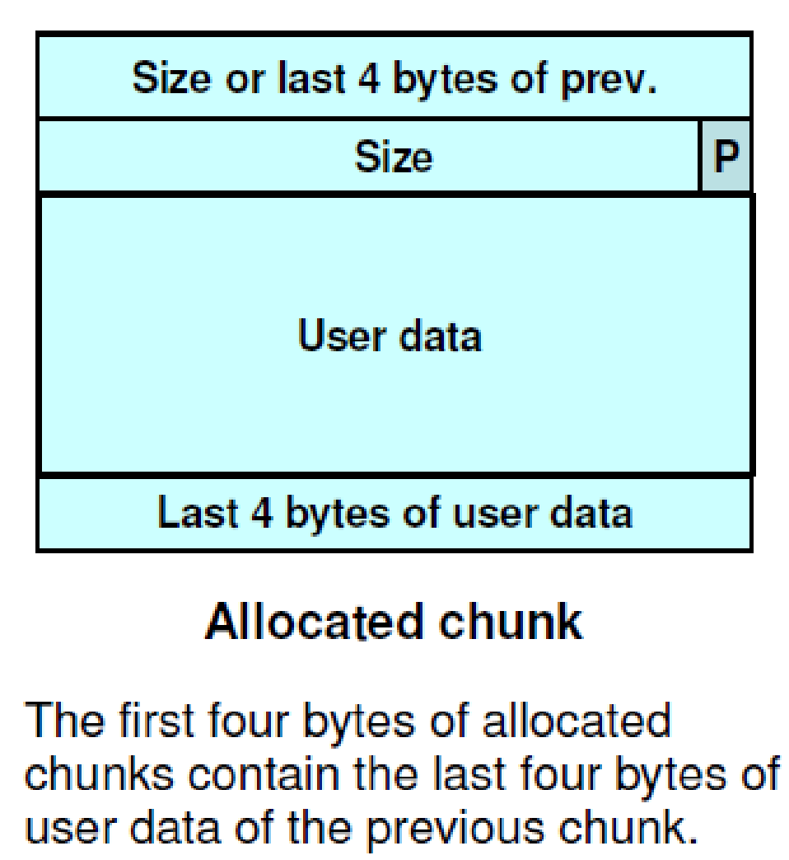
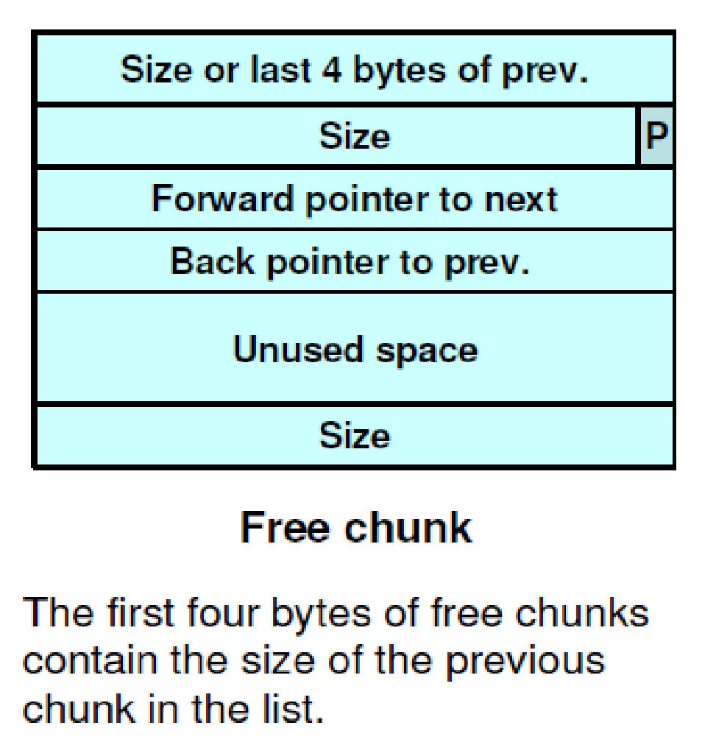
Doug Lea’s Memory Allocator (dlmalloc)
Used in most modern GNU/Linux libc implementations.
Free chunks organized into doubly linked lists (similar to traditional malloc).

Slide 24
PREV_INUSE Bit:
Indicates weather the previous bit is allocated or not.
Chunks sizes are always 2-byte multiples – the LSB (PREV_INUSE) being 0.
PREV_INUSE == 1 . Chunk allocated.

Slide 25
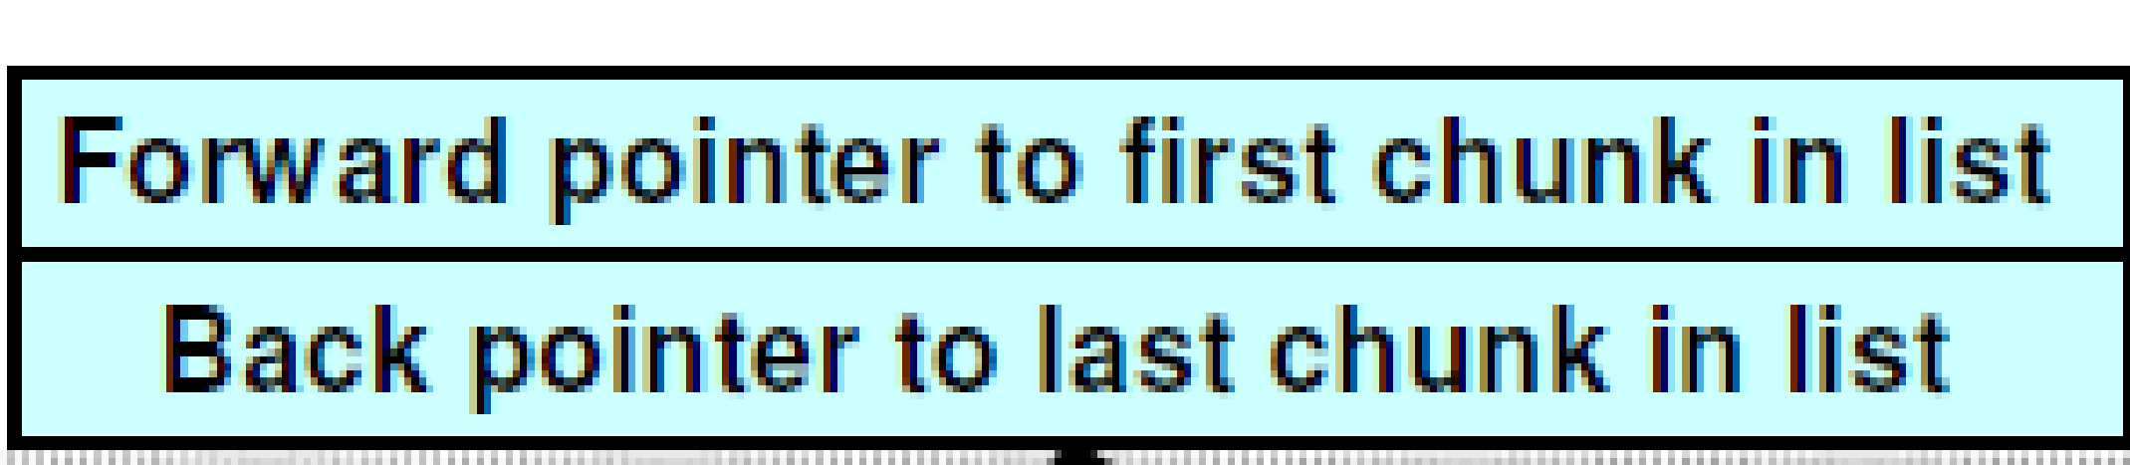
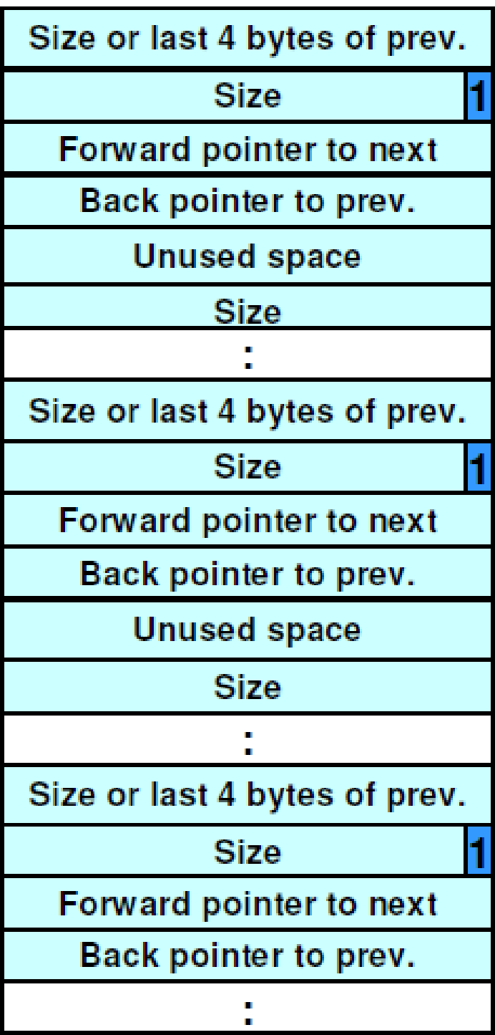
Free List of dlmalloc

Slide 26
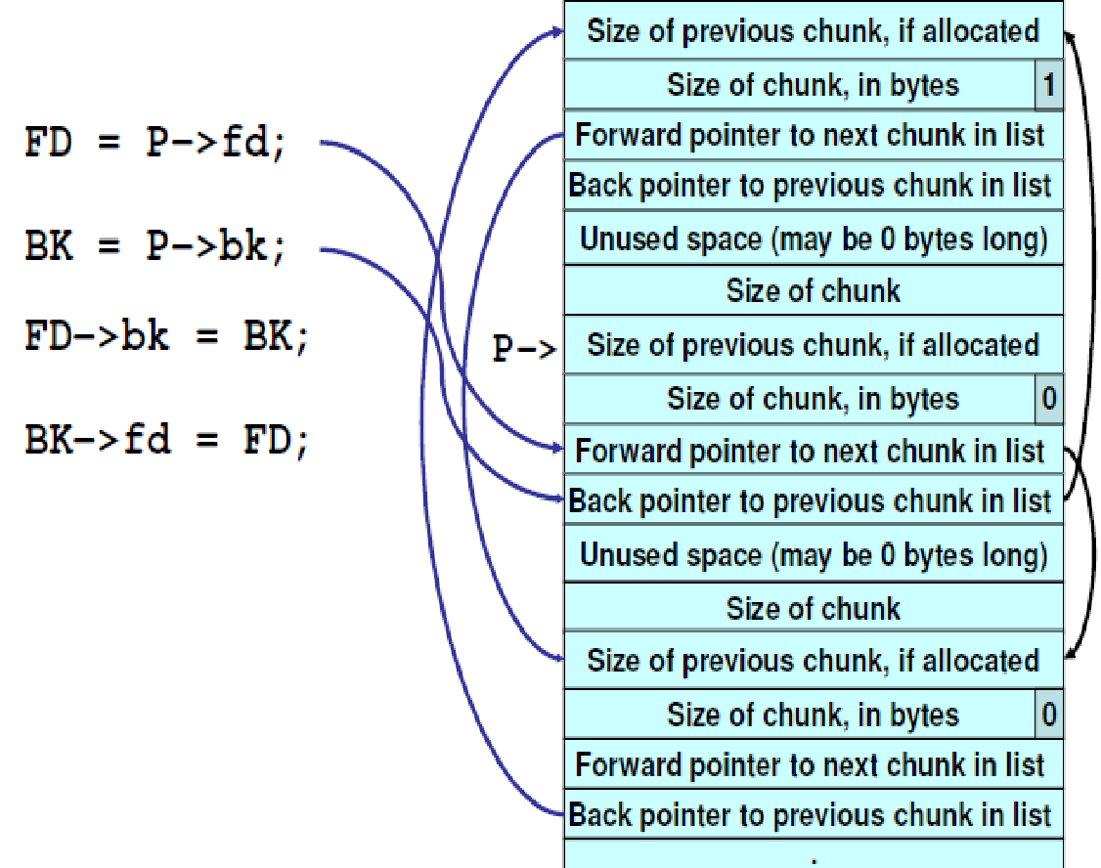
Buffer Overflow through Heaps
Unlink technique:
The unlink macro:
#define unlink (P, BK, FD) {
FD = P->fd; \
BK = P->bk; \
FD->bk = BK; \
BK->fd = FD; \
}
Unlink macro called when free()-ing
a chunk of memory – specifically
when consolidating chunks.

Slide 27

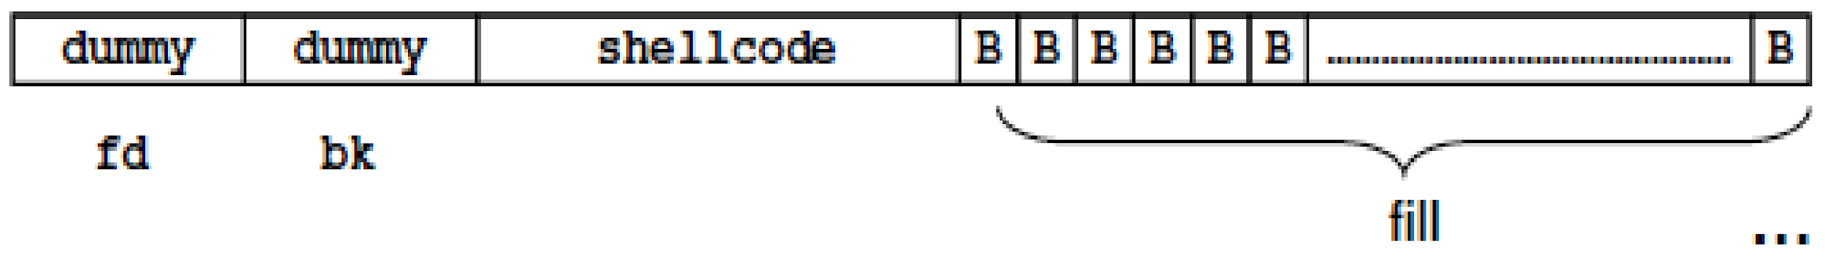
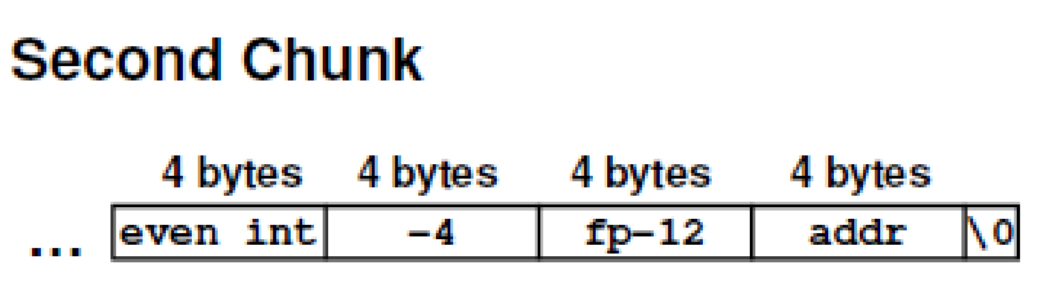
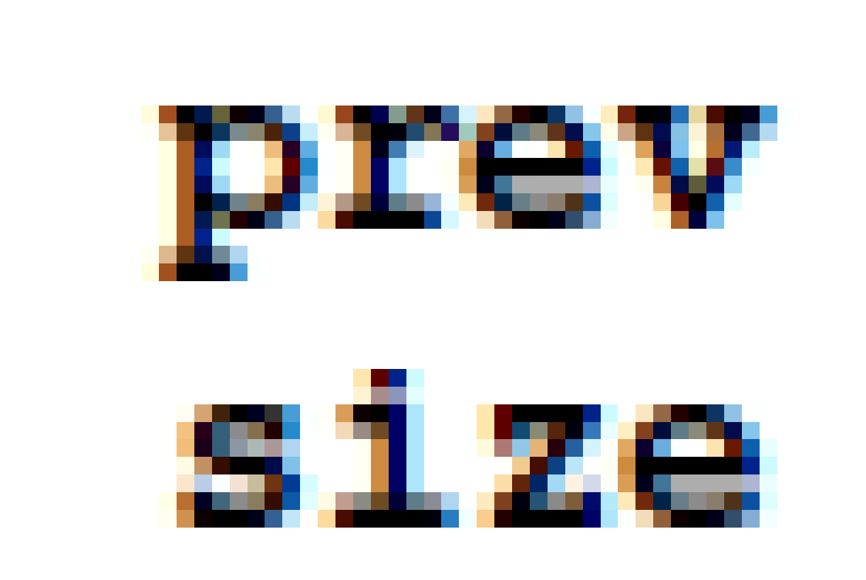


Buffer Overflow through Heaps
void main(int argc, unsigned char **argv)
{
char *first,*second,*third;
first = malloc(666);
second = malloc(12);
third = malloc(12);
strcpy(first,argv[1]);
free(first);
free(second);
free(third);
return 0;
}

Slide 28
Buffer Overflow through Heaps
argv[1] is very large and overflows the “chunk boundary” and writes over the prev_size, size, fd, bk in the next chunk.
Unlink() macro allows writing the arbitrary value (addr) to arbitrary memory location (fp).
Size of the second heap-buffer is -4 (0xfffffffc).
The current (second) chunk looks like the third.
Effective operation:
FD = P->fd;
BK = P->bk;
FD->bk = BK; // *(P->fd+12)= BK
BK->fd = FD; // *(P->bk+8) = FD
addr could be address of the shellcode and the fp could be the return address on the stack or some functions address obtained from the GOT table.
Replacing GOT address works only in Linux and not in Windows.

Slide 29
Return to libc Attack: Using system() function
Basic stack layout Stack layout to return to
libc function system()
Function() args.
Saved return address 2
Function() args.
Saved return address 1
Saved frame pointer
…
Buffer[1024]
…
Arg. for system()
Dummy return address
Address of system() function of libc
Saved frame pointer
…
Buffer[1024]

Slide 30
Return to libc Attack: Using system() function
Real example
-Local variables in stack: 4 bytes (int) + 8 bytes (pointer) + 256 byte(array).
-How it is actually arranged: buff+256+saved RBP+return address+8 bytes(pointer)+4 bytes(int).
-Address of system() function: can be obtained from gdb.
-What needs to be passed as input:
<Dummy data ‘A…’ 264>+<address of system function in LE order>+<Dummy return address>+<address of string “/bin/sh”>
- How load “/bin/sh” into the program memory -- $export SHELL=/bin/sh – search for the variable through GDB shell variables.
#include <stdio.h>
int main(int argc, unsigned char **argv) { unsigned char buff[256];
memcpy(buf,argv[1],strlen(argv[1]));
printf(buf);
}

Slide 31
Return to libc Attack: Gadgets Using Libc Instructions
Problems with the previous approach ?
System() function take arguments on the stack
Solution ?
Solution – use execl() family system calls with arguments passed via the registers.
Recall register calling conventions for linux syscalls:
%rdi = param 1
%rsi = param 2
%rdx = param 3
%rcx = param 4
%r8 = param 5
%r9 = param 6

Slide 32
Return to libc Attack: Gadgets Using Libc Instructions
Passing address to stack is easy but how do you pass arguments?
Chain up series of POP/RET instructions where information is popped to the registers
At the end there should be the address of execve().
Function usage:
execve(“/bin/sh”,NULL,0);
pop %rdi
retq
pop %rsi
retq
pop %rdx
retq
<execve address>

Slide 33
Return to libc Attack: Gadgets Using Libc Instructions
How to get specific sequence of instructions:
Search libc.so binary for the specific sequence corresponding to POP/RET opcodes.
5f pop %rdi
5e pop %rsi
5a pop %rdx
3c retq
Search for ‘pop %rdi , retq’ ‘pop %rsi , retq’ ‘pop %rdx , retq’ combinations in the libc library

Slide 34
Return to libc Attack: Gadgets Using Libc Instructions
The sequences of POP/RETs obtained are called Gadgets.
How to get the address to a gadget ?
Run the victim program and obtain the memory map from /proc/pid/maps.
# grep libc /proc/28258/maps
7ffff7a57000-7ffff7bd4000 r-xp 00000000 08:05 46534885 /lib/libc-2.11.1.so
7ffff7bd4000-7ffff7dd3000 ---p 0017d000 08:05 46534885 /lib/libc-2.11.1.so
7ffff7dd3000-7ffff7dd7000 r--p 0017c000 08:05 46534885 /lib/libc-2.11.1.so
7ffff7dd7000-7ffff7dd8000 rw-p 00180000 08:05 46534885 /lib/libc-2.11.1.so
The Gadget ‘offsets’, obtained from the search, are to be added to the base address of the location where libc is loaded – virtual addresses of the Gadgets
Obtain the ‘offset’ of execve function through ‘nm’ program and add it to base address of libc – virtual address of execve() function.
REPEAT for every POP/RET sequence – ‘pop %rdi , retq’ ‘pop %rsi , retq’ ‘pop %rdx , retq’

Slide 35
Return to libc Attack: Gadgets Using Libc Instructions
/bin/sh + 0x00 512 bytes (buff[512])
Dummy value → %rbp (dummy frame ptr)
Address of libc: pop %rdi , retq
&buff
Address of libc: pop %rsi , retq
NULL → %rsi
Address of libc: pop %rdx , retq
NULL → %rdx
Address of libc: execve()

Slide 36

Vernam Cipher (One Time Pads)
Vernam Cipher (One Time Pads (OTPs)) (1917):
Each bit of the plain text is XOR-ed with each bit of the key stream
Security lies in length and pseudo-randomness of the key stream
Most basic operation: Message XOR key
Best use case: Use each key ONLY once (ONE TIME…) (considered cryptographically secure…(Shannon – “Perfect Secrecy”)).
Pr (E(M₁, K₁)) = Pr (E(M₂, K₂)) (for every K_{i} in K (key space)).
(Cipher text should not reveal the corresponding Message)
PLAINTEXT : H(7) E(4) L(11) L(11) O(14)
KEY : X(23) M(12) C(2) K(10) L(11) + (mod 26)
CIPHER : E(4) Q(16) N(13) V(21) Z(25)
M₁ XOR K₁ → C₁
M₂ XOR K₂ → C₂

Slide 37
Stream Ciphers
OTP → Stream Ciphers
Each key must be used exactly one.
Multiple usage of same key → statistical cryptanalysis attack
Reusable keying material
Generate new keys without revealing how they are generated.
The encrypted cipher text should not reveal any information about the key or the plaintext.
Each bit of the message is XOR-ed with the bit of the key.
Problem with Shannon’s “Perfect Secrecy”: Key len ≥ Message Len
Solution: PRG instead of perfectly random function.
PRG: G:{0,1}^{s}→{0,1}^{n} n >> s
E = G(k) M = C
D =G(k) C = M
Important property of PRG:
Unpredictability: Knowing some bits
of the key one should not be able to predict
the remaining bits.
k
Initial seed
G(k)
Expanded by PRG fn.
M
C

Slide 38
Block Ciphers
Message (M) divided into multiple blocks
M₁
M₂
M₃
M₄
M_{n-1}
M_{n}
C₁
C₂
C₃
C₄
E
E
E
E
K
K
K
K
K
K₁
K₂
K₃
K_{n}
n-bits
M
C
Input: n-bits Output: n-bits
Key: ≥ n-bits
f₁(K₁ , •)
f₂(K₂ , •)
f₁(K₁ , •)
f_{n}(K_{n} , •)
m₁
m₂
m_{n}

Slide 39
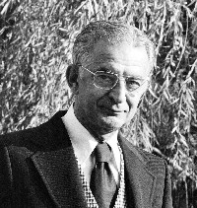
Brief History of Block Ciphers
Early 1970s: Horst-Feistel proposed Lucifer block
cipher.
Block size : 128-bits, Key: 128-bits
1973: NBS (now NIST) asked for block cipher
proposals.
IBM submits Lucifer.
1976: NBS adopts Lucifer with shorter key length and it is called
Data Encryption Standards (DES).
- Block size: 64-bits key-len: 56-bits
1997: DES broken by exhaustive search (brute force search).
2000: NIST adopts Rijndael as AES and replaces DES.

Slide 40
DES: core idea – Feistel Network
Given functions f₁, …, f_{d}: {0,1}^{n} ⟶ {0,1}^{n}
Goal: build invertible function F: {0,1}^{2n} ⟶ {0,1}^{2n}
R₀
R₁
R₂
R_{d-1}
R_{d}
n-bits
f₁
f₂
⋯
f_{d}
L₀
L₁
L₂
L_{d-1}
L_{d}
n-bits
⊕
⊕
⊕
input
output
In symbols: R_{i} = F_{i}(R_{i-1}) L_{i}
L_{i} = R_{i-1}
⊕
Slides Courtesy:
Dan Boneh

Slide 41
DES: 16 round Feistel network
f₁, …, f₁₆: {0,1}³² ⟶ {0,1}³² , f_{i}(x) = F( k_{i}, x )
(Round key derived
from key K)
56-bit key expanded
into 16 48-bit round keys
k
key expansion
⋯
k₁
k₂
k₁₆
16 round Feistel network
IP
IP⁻¹
64 bits
64 bits
input
output
Slides Courtesy:
Dan Boneh
To invert, use keys in reverse order

Slide 42
DES challenge
msg = “ The unkn own mess ages is: XXXX … “
CT = c₁ c₂ c₃ c₄
Goal: find k ∈ {0,1}⁵⁶ s.t. DES(k, m_{i}) = c_{i} for i=1,2,3
1997: Internet search -- 3 months
1998: EFF machine (deep crack) -- 3 days (250K $)
1999: combined search -- 22 hours
2006: COPACOBANA (120 FPGAs) -- 7 days (10K $)
⇒ 56-bit ciphers should not be used !! (128-bit key ⇒ 2⁷² days)
Slides Courtesy:
Dan Boneh

Slide 43
AES-128 schematic
10 rounds
4
ByteSub
ShiftRow
MixColumn
ByteSub
ShiftRow
MixColumn
ByteSub
ShiftRow
input
⋯
4
⨁
⨁
⨁
⨁
invertible
k₀
k₁
k₂
k₉
⨁
k₁₀
key
output
4
key expansion:
16 bytes
16 bytes ⟶176 bytes
4
Slides Courtesy:
Dan Boneh

Slide 44
Code size/performance tradeoff
 | Code size | Performance
Pre-compute round functions (24KB or 4KB) | largest | fastest: table lookups and xors
Pre-compute S-box only (256 bytes) | smaller | slower
No pre-computation | smallest | slowest
Slides Courtesy:
Dan Boneh

Slide 45
AES in hardware
AES instructions in Intel Westmere:
aesenc, aesenclast: do one round of AES
128-bit registers: xmm1=state, xmm2=round key
aesenc xmm1, xmm2 ; puts result in xmm1
aeskeygenassist: performs AES key expansion
Claim 14 x speed-up over OpenSSL on same hardware
Similar instructions on AMD Bulldozer
Slides Courtesy:
Dan Boneh
Notes:
To implement AES called aesenc 9 times and then call aesenclast.

Slide 46

Solution 2: nonce-based Encryption
nonce
Alice
Bob
m, n
E
E(k,m,n)=c
c, n
D
D(k,c,n)=m
k
k
nonce n: a value that changes from msg to msg.
(k,n) pair never used more than once
method 1: nonce is a counter (e.g. packet counter)
used when encryptor keeps state from msg to msg
if decryptor has same state, need not send nonce with CT
method 2: encryptor chooses a random nonce, n ← N
Slides Courtesy:
Dan Boneh
Notes:
File encryption: random nonce, no state from file to file
SSL encrytpion (in order delivery): counter is fine, no need to send nonce to peer.
IP sec (out of order delivery): counter is fine, but need to include nonce in every packet.

Slide 47
Message Integrity
Goal: integrity, no confidentiality.
Examples:
Protecting public binaries on disk.
Protecting banner ads on web pages.
Slides Courtesy:
Dan Boneh

Slide 48
Message integrity: MACs
k
k
message m
tag
Alice
Bob
Generate tag:
tag ← S(k, m)
Verify tag:
V(k, m, tag) = `yes’
?
Def: MAC I = (S,V) defined over (K,M,T) is a pair of algs:
S(k,m) outputs t in T
V(k,m,t) outputs `yes’ or `no’
Slides Courtesy:
Dan Boneh

Slide 49
Integrity requires a secret key
message m
tag
Alice
Bob
Generate tag:
tag ← CRC(m)
Verify tag:
V(m, tag) = `yes’
?
Attacker can easily modify message m and re-compute CRC.
CRC designed to detect random, not malicious errors.
Slides Courtesy:
Dan Boneh

Slide 50
Attacks Against MACs
Existential Forgery: The attacker produces a signature s of some message m of his choice.
Selective Forgery: The attacker chooses a message m, then gets access to the public key used for verification, and produces a signature s of m.
Key recovery: Given the public key for verification, the attacker produces the secret key for signing.
Slides Courtesy:
Dan Boneh

Slide 51
Why the last encryption step in ECBC-MAC?
Adversary works as follows:
Choose an arbitrary one-block message m∈X
Request tag for m. Get t = F(k,m)
Output t as MAC forgery for the 2-block message m’ = (m, t⊕m)
rawCBC(k, (m, t⊕m) ) = F(k, F(k,m)⊕(t⊕m) ) = F(k, t⊕(t⊕m) ) = t
Slides Courtesy:
Dan Boneh
Notes:
Note that forgery is an extension of query. rawCBC is a secure PRF if no message is a prefix of another (e.g. if all messages are same length).

Slide 52
The Merkle-Damgard Iterated Construction
m[0]
m[1]
m[2]
m[3] ll PB
IV
(fixed)
h
h
h
h
H(m)
H₀
H₁
H₂
H₃
H₄
PB: padding block
1000…0 ll msg len
If no space for PB add another block
Slides Courtesy:
Dan Boneh
64 bits

Slide 53
Standardized method: HMAC (Hash-MAC)
Most widely used MAC on the Internet.
Use for calculating a message authentication code (MAC) involving a cryptographic hash function that may use a secret cryptographic key.
H: hash function.
example: SHA-256 ; output is 256 bits
Building a MAC out of a hash function:
HMAC: S( k, m ) = H( k⊕opad , H( k⊕ipad ll m ) )
Slides Courtesy:
Dan Boneh

Slide 54
Euler’s generalization of Fermat
Def: For an integer N define ϕ (N) = |(Z_{N})*| (Euler’s ϕ func.)
Examples: ϕ (12) = |{1,5,7,11}| = 4 ; ϕ (p) = p-1
For N=p⋅q: ϕ (N) = N-p-q+1 = (p-1)(q-1)
Thm (Euler): ∀ x ∈ (Z_{N})* : x^{ϕ(N)} = 1 in Z_{N} (Generalization of Euler’s thm)
Example: 5^{ϕ(12)} = 5⁴ = 625 = 1 in Z₁₂ Generalization of Fermat. Basis of the RSA cryptosystem.
Slides Courtesy:
Dan Boneh

Slide 55
Trapdoor functions (TDF)
Def: a trapdoor func. X⟶Y is a triple of efficient algs. (G, F, F⁻¹)
G(): randomized alg. outputs a key pair (pk, sk)
F(pk,⋅): det. alg. that defines a function X ⟶ Y
F⁻¹(sk,⋅): defines a function Y ⟶ X that inverts F(pk,⋅)
Slides Courtesy:
Dan Boneh

Slide 56
Public-key encryption from TDFs
(G, F, F⁻¹): secure TDF X ⟶ Y
(E_{s}, D_{s}) : symmetric auth. encryption defined over (K,M,C)
H: X ⟶ K a hash function
E( pk, m) :
x ⟵ X, y ⟵ F(pk, x)
k ⟵ H(x), c ⟵ E_{s}(k, m)
output (y, c)
D( sk, (y,c) ) :
x ⟵ F⁻¹(sk, y),
k ⟵ H(x), m ⟵ D_{s}(k, c)
output m
R
Slides Courtesy:
Dan Boneh

Slide 57
The RSA trapdoor permutation
First published: Scientific American, Aug. 1977.
Very widely used:
SSL/TLS: certificates and key-exchange
Secure e-mail and file systems
… many others
Slides Courtesy:
Dan Boneh

Slide 58

The RSA trapdoor permutation
G(): choose random primes p,q ≈1024 bits. Set N=pq.
choose integers e , d s.t. e⋅d = 1 (mod ϕ(N) )
output pk = (N, e) , sk = (N, d)
F( pk, x ): ; RSA(x) = x^{e} (in )
F⁻¹( sk, y) = y^{d} ; y^{d} = RSA(x)^{d} = x^{ed} = x^{kϕ(N)+1} = (x^{ϕ(N)})^{k} ⋅ x = x
Slides Courtesy:
Dan Boneh

Slide 59
RSA Pub-Key Encryption (ISO Std.)
(E_{s}, D_{s}): symmetric enc. scheme providing auth. encryption.
H: Z_{N} → K where K is key space of (E_{s},D_{s})
G(): generate RSA params: pk = (N,e), sk = (N,d)
E(pk, m): (1) choose random x in Z_{N}
(2) y ← RSA(x) = x^{e} , k ← H(x)
(3) output (y , E_{s}(k,m) )
D(sk, (y, c) ): output D_{s}( H(RSA⁻¹ (y)) , c)
Slides Courtesy:
Dan Boneh
Notes:
AE-secure: the scheme provides Authenticated Encryption.
Resulting system is chosen ciphertext secure (in the random oracle model).

Slide 60
Textbook RSA is Insecure
Textbook RSA encryption:
public key: (N,e) Encrypt: c ⟵ m^{e} (in Z_{N})
secret key: (N,d) Decrypt: c^{d} ⟶ m
Insecure cryptosystem !!
Is not semantically secure and many attacks exist
⇒ The RSA trapdoor permutation is not an encryption scheme !
Slides Courtesy:
Dan Boneh

Slide 61
Diffie Hellman Key Exchange: Key exchange Without an Online TTP.
Goal: Alice and Bob want shared secret, unknown to eavesdropper
For now: security against eavesdropping only (no tampering)
Alice
Bob
eavesdropper

Slide 62
The Diffie-Hellman protocol (informally)
Fix a large prime p (e.g. 600 digits)
Fix an integer g in {1, …, p}
Alice
Bob
choose random a in {1,…,p-1}
choose random b in {1,…,p-1}
“Alice”: A ← gª (mod p)
“Bob”: B ← g^{b} (mod p)
Bª (mod p) = (g^{b})ª =
k_{AB} = g^{ab} (mod p)
= (gª)^{b} = A^{b} (mod p)
Notes:
“Alice”, A = ga (mod p) ; “Bob”, B = gb (mod p)

Slide 63
Man-in-the-Middle (MITM) Attack
As described, the protocol is insecure against active attacks
Alice
MiTM
Bob
A ← gª (mod p)
A’ ← g^{a’} (mod p)
B’ ← g^{b’} (mod p)
B ← g^{b} (mod p)
g^{ab’} (mod p), g^{a’b} (mod p)

Slide 64
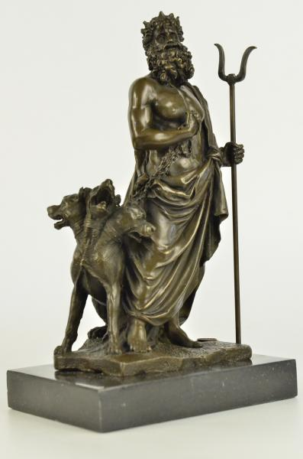
Kerberos
Brief background:
Developed in MIT for Project Athena to protect network services.
Based on Needham Schroeder symmetric key protocol.
V1-4 directed towards Project Athena.
V5 appeared as RFC 1510 – Was classified as aux. military technology
and banned its export because it involved using DES.
Non-US V4 designed by Royal Inst. of Technology in Sweden.
Latest version: 2005 (designed by the IETF Kerberos Working Group)
Objective:
Used to authenticate users and allow nodes to communicate with one another over a non-secure medium. Confidentiality and forward secrecy assured.
Implementations
Used in Microsoft Active Directory server in Win 2k server, 2003 R2, 2008, 2008 R2 and 2012 R2

Slide 65
Basics of Kerberos Protocol
Objective:
Designed for client-sever environment wherein a user might want to use a service over an insecure medium (e.g. LAN).
Use cases: Print server, remote login shell, DNS, domain authentication etc.
Network entities
Server – resource that could be accessed by the client and TGS
Client – wants to access the resource.
Ticket – a temporal access privilege assurance to the resource.
Ticket Granting Server – the server that issues the ticket.
KDC – key distribution server – knows about the private keys of all entities.

Slide 66


The Actual Protocol
Authentication
Server
KDC
Client → AS: user ID (1)
Client
Enc. Key K_{C} ← H(password)
E(K_{C,TGS})_{Kc}
E(TGT) _{KTGS}
TGS
E(TGT) _{KTGS} || E(Authenticator) _{C,TGS}
E(Client-to-server ticket) _{KS}
E(K_{C,S}) _{Kc,TGS}
Server
E(Client-to-server ticket) _{Ks} || E(Authenticator) _{Kc,S}
E(TS in Authenticator + 1) _{Kc,S}

Slide 67
Key Drawbacks of Kerberos
Availability of KDC + centralized point of failures and vulnerabilities.
Time synchronization and strict deadlines.
No standardized implementations.
Scalability : Every user and server needs it own private keys.

Slide 68
Public-Private World!: Public Key Infrastructure (PKI)
Basics:
Relies on a centralized authority, aka Certificate Authority (CA).
Users generally have their own identities – public-private key pair , username etc. which are attested by the CA and stored in the form on certificates.
Most common form of certificates – X.509 certificate format.
Traditional scenarios – single CA based.
Multiple CA model – hierarchy, cross-validation, bridging model

Slide 69
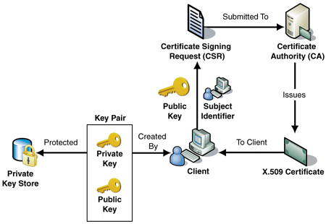
Basic model

Slide 70
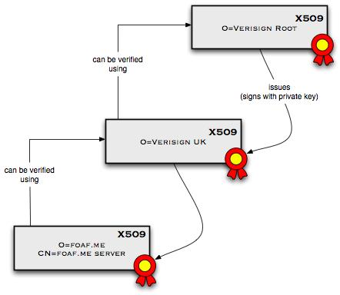
Certificate Chaining

Slide 71
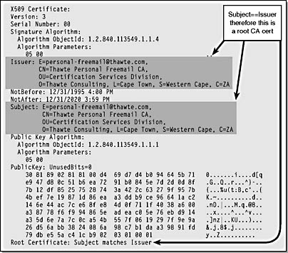
X.509 Certificate Format

Slide 72

Client-Server Certificate Authentication:
Basics of TLS Protocol
Multi-step authentication, certificate and key exchange protocol.
Client → Hello → Server
Server → Hello, My cert., Key XCHG., → Client
Client: Verify server cert.
Client → Key XCHG, My enc. algos. → server
Server →Lets choose algo. A → server
Client ← encrypted channel → server
Client Hello
Server Hello, Server Cert., Server Key XCHG, Server Hello Done
Client
Cert. Verify, Client Key XCHG, Change Cypher Spec., Client Finish Msg.
Server
Change Cypher Spec., Server Finish Msg.
Encrypted Channel Established

Slide 73
Basic Functionalities
Authentication: Validates user credentials
Account Functions: Authorization
Session : Set-up or remove environment variables
Password: Modules responsible for updating various service authentications details.

